Slide 1


MOORED BUOY DATA ANALYSIS USING ADVANCED MACHINE LEARNING METHODS
Guided by –
Guide - Prof. Rajeev Sharma (faculty IITM)
Co guide - Mr. Sundar R (Scientist E, NIOT)
Submitted by-
Amit Dadasaheb Pawar (OE23M024)

Slide 2
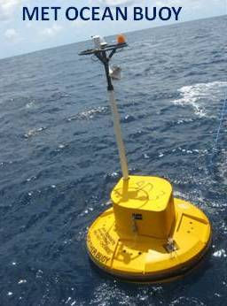
OVERVIEW OBJECTIVES LITERATURE SURVEY METHODOLOGY RESULTS COMPARISONS
NATIONAL INSTITUTE OF OCEAN TECHNOLOGY
The National Institute of Ocean Technology (NIOT), based in Chennai, operates under the Ministry of Earth Sciences, India.
It is one of the premier institutes focusing on developing technologies for the sustainable utilization of ocean resources.
NIOT has made significant contributions to ocean research, providing technological solutions for societal needs, and advancing ocean science.
Ocean Observation System (OOS) Department
The Ocean Observation System (OOS) department at NIOT plays a crucial role in gathering real-time data from the ocean, which is essential for understanding ocean dynamics and supporting scientific research.
The department aims to monitor and collect data from India's vast maritime zones, which is vital for meteorological, climatological, environmental, and research purposes.

Slide 3
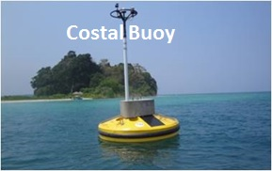
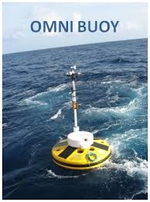
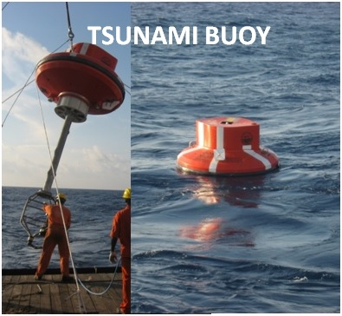
OVERVIEW OBJECTIVES LITERATURE SURVEY METHODOLOGY RESULTS COMPARISONS
Activities of OOS Department
Mandate
Maintain a network of moored buoys (Met Ocean, CAL-VAL, Tsunami) and disseminate real-time data to INCOIS.
Support the RAMA program, develop observational tools, and conduct collaborative R&D projects with institutes globally.
Buoy Network
The network consists of 12 OMNI buoys, 4 coastal buoys, 1 CAL-VAL buoy, 2 Tsunami buoys, and other specialized buoys.
Includes IndARC mooring in Norway, ADCP mooring, and Directional Wave Rider buoy off Chennai.
Data Dissemination to INCOIS
Real-time data is sent to INCOIS every three hours via email, VSAT, and FTP.
High-resolution data from retrieved buoys is also provided for comprehensive analysis.
Maintenance & Sustenance of Moored Buoy
Network The buoys are serviced periodically to collect real-time data and maintain functionality.
Functional buoys dropped post-Dec 2018 due to Inmarsat LES switchover issues.
Data Validation
Data quality ensured through inter-comparisons with reference systems and calibration.
Validated current, conductivity, and temperature measurements, showing good agreement.
Data Collection for Scientific Research
Objectives of OOS Department
Support for Marine Activities
Early Warning Systems

Slide 4
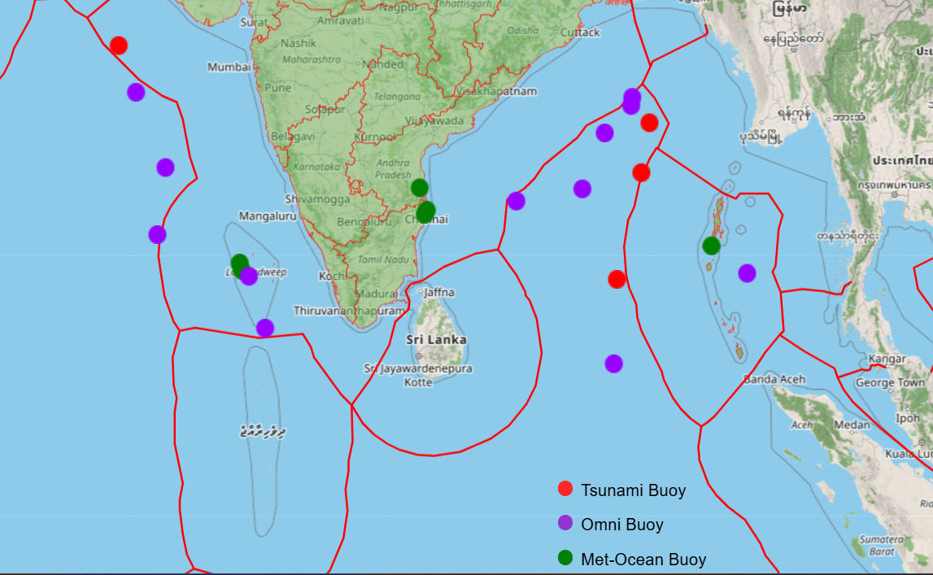
OVERVIEW OBJECTIVES LITERATURE SURVEY METHODOLOGY RESULTS COMPARISONS
Types of Buoys Used:
Moored Buoys: Anchored at specific locations, providing long-term time-series data for targeted study areas.
Drifting Buoys: These buoys are not fixed and are used to gather data while moving with ocean currents.
Tsunami and Storm Surge Buoys: Specially designed to detect sudden changes in sea levels and provide early warnings for events like tsunamis.
Moored Buoys in Ocean :
The Moored Buoy System is one of the significant projects managed by the Ocean Observation System department.
Moored buoys are floating observational platforms anchored to the seabed, equipped with various sensors to collect environmental data.

Slide 5
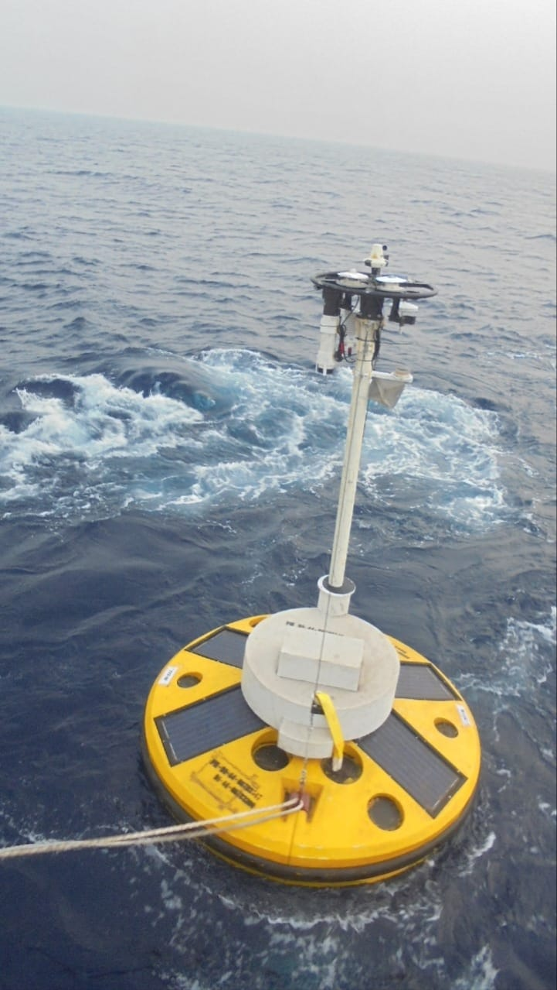
OVERVIEW OBJECTIVES LITERATURE SURVEY METHODOLOGY RESULTS COMPARISONS
Project Objectives:
To analyze moored data buoy time series data using advanced machine learning techniques to extract meaningful patterns, trends, and predictive insights
Develop models to predict future values based on historical time series data.
Improve the accuracy and efficiency of traditional data analysis methods by applying machine learning techniques

Slide 6
OVERVIEW OBJECTIVES LITERATURE SURVEY METHODOLOGY RESULTS COMPARISONS
RESEARCH PAPER | AUTHOR | SUMMARY
A data-driven methodology for wave time-series measurement on floating structures | Jianhong Zhang , Wenyue Lu, Jun Li , Xin Li, Zhengshun Cheng (journal homepage: www.elsevier.com/locate/oceaneng ) | Paper presents a data driven model that utilizes artificial neural networks to estimate incident wave elevation based on the motion and air-gap responses of floating structures.
Comparing machine learning-based sea state estimates by the wave buoy analogy | Ulrik D. Nielsen , Kazuma Iwase b , Raphaël E.G. Mounet | Paper presents a comparison of three different machine learning frameworks applied in the wave buoy analogy use for estimating the sea state from measured ship responses.
Advanced Moored Data Buoys for Catching Typhoons in the Western North Pacific | Yiing Jang Yang , Chien-Yi Yang, Ming-Huei Chang, Ching-Ling Wei | Article introduced the continuously self improving and power efficient buoys capable of observing meteorogical and ocean data under extreme weather conditions

Slide 7
OVERVIEW OBJECTIVES LITERATURE SURVEY METHODOLOGY RESULTS COMPARISONS
RESEARCH PAPER | AUTHOR | SUMMARY
The global tropical moored buoy array | M. J. McPhaden , K. Ando , B. Bourlès , H. P. Freitag , R. Lumpkin, Y. Masumoto , V. S. N. Murty , P. Nobre , M. Ravichandran ,J. Vialard , D. Vousden W. Yu | This paper describes the Global Tropical Moored Buoy Array (GTMBA), which is a multi-national effort to provide data in real time for climate research and forecasting. Components of the global array include the Tropical Atmosphere Ocean, the Prediction and Research Moored Array in the Tropical Atlantic (PIRATA), and the Research Moored Array for African-Asian-Australian Monsoon Analysis and Prediction (RAMA) in the Indian Ocean.
Machine learning framework for the real-time reconstruction of regional 4D ocean temperature fields from historical reanalysis data and real-time satellite and buoy surface measurements | Bianca Champenois , Themistoklis Sapsis | This paper presents a computational framework that combines historical model data and real-time sensor measurements. It accurately predicts 4D ocean temperature fields with a median absolute error of 0.97°C.

Slide 8
OVERVIEW OBJECTIVES LITERATURE SURVEY METHODOLOGY RESULTS COMPARISONS
Data Collection & Data Cleaning
Data Preprocessing
Feature Engineering
Appropriate Model Selection
Training the Model
Model Integration
Prediction & Forecasting
Result Evaluation & Conclusion

Slide 9
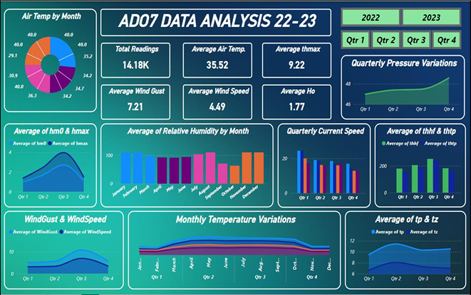
OVERVIEW OBJECTIVES LITERATURE SURVEY METHODOLOGY RESULTS COMPARISONS

Slide 10
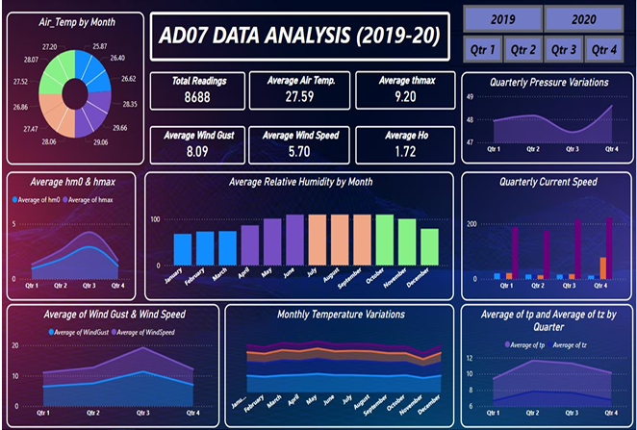
OVERVIEW OBJECTIVES LITERATURE SURVEY METHODOLOGY RESULTS COMPARISONS

Slide 11
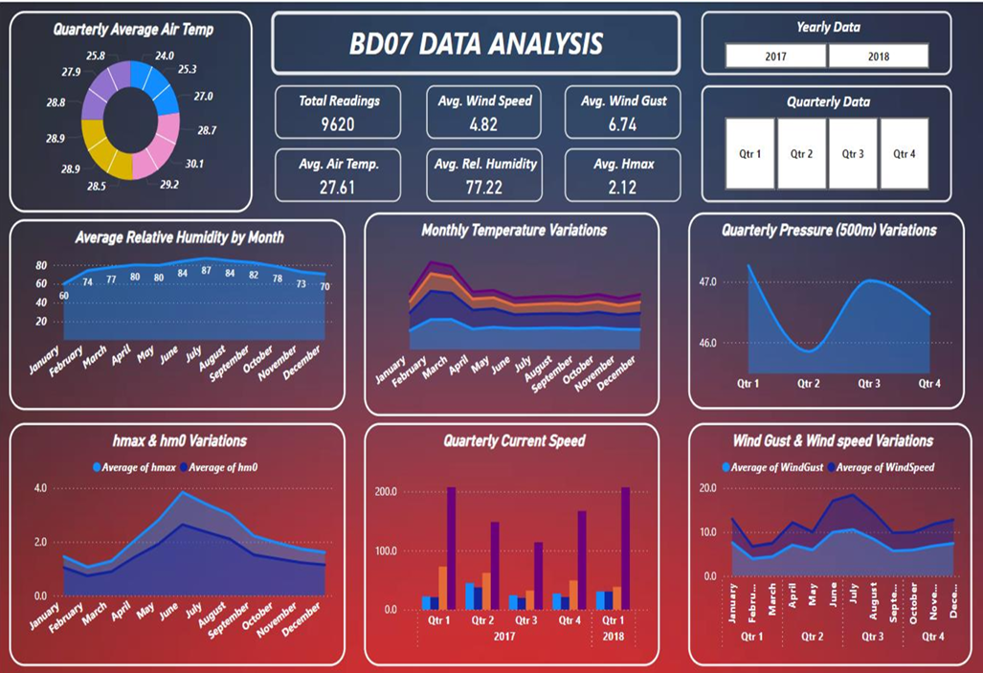
OVERVIEW OBJECTIVES LITERATURE SURVEY METHODOLOGY RESULTS COMPARISONS

Slide 12
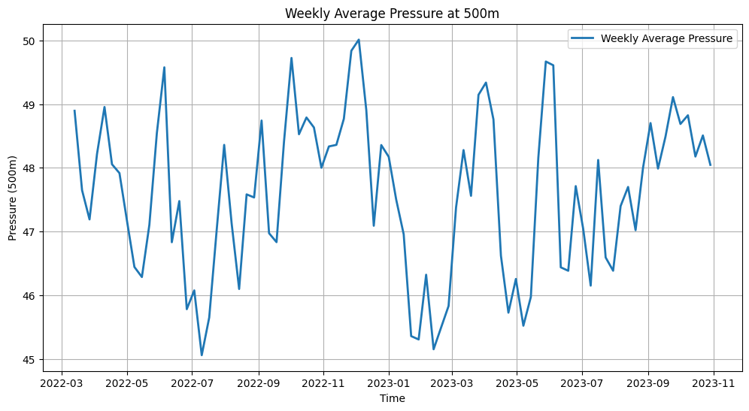
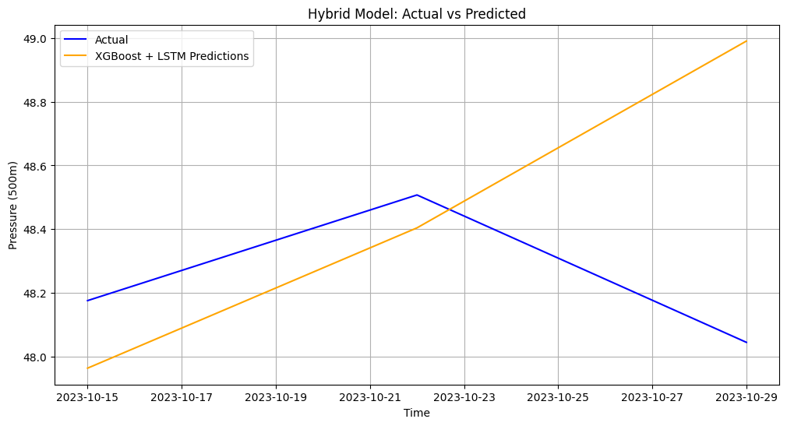
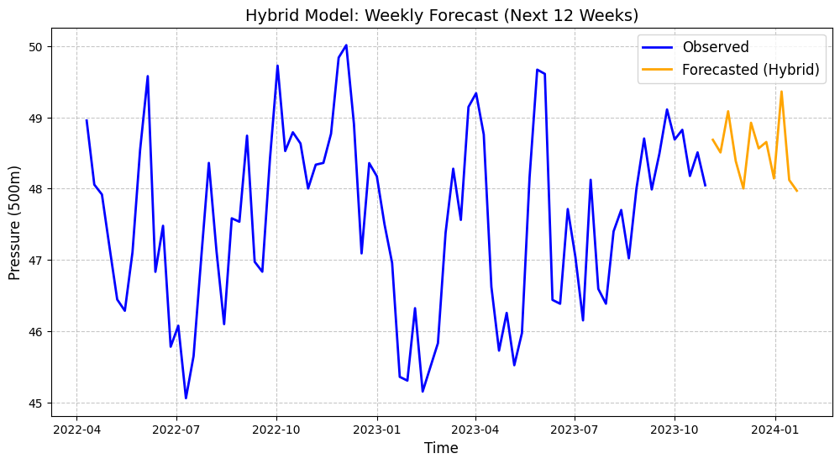
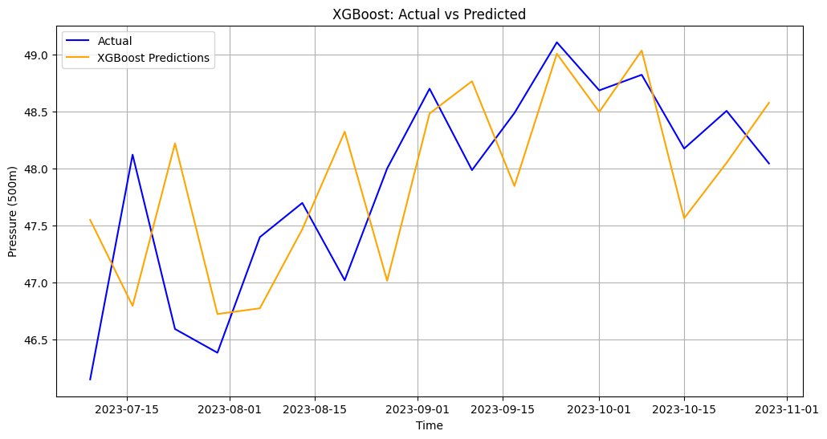
OVERVIEW OBJECTIVES LITERATURE SURVEY METHODOLOGY RESULTS COMPARISONS
AD07 (2022 - 2023) Prediction results for Pressure

Slide 13
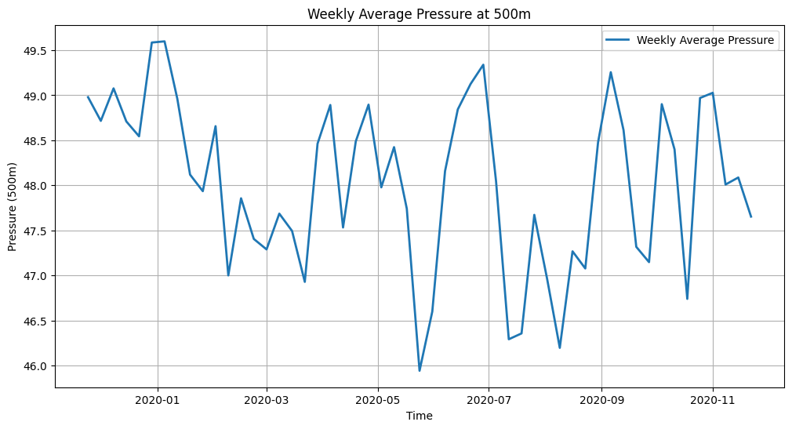
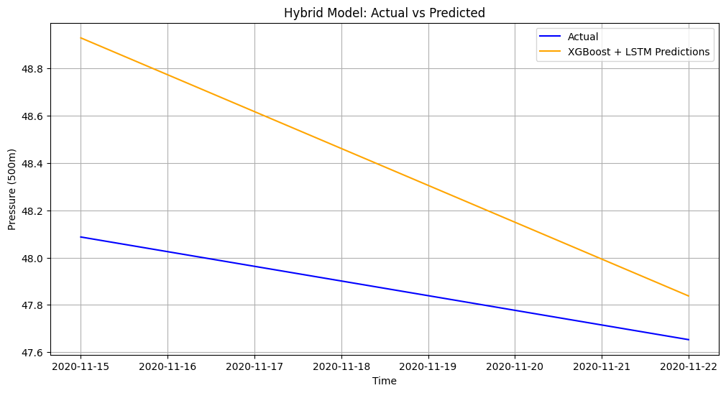
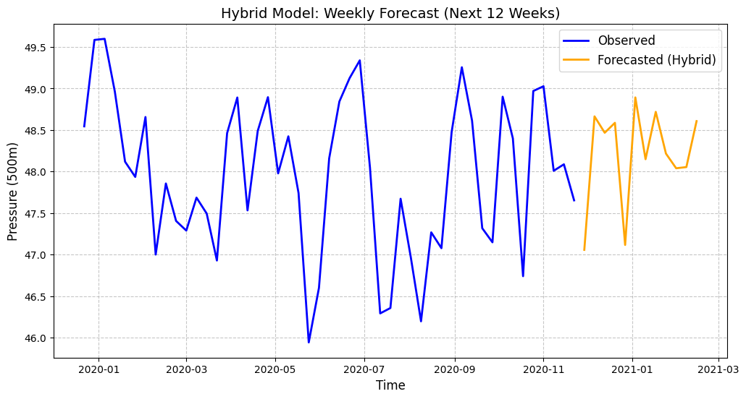
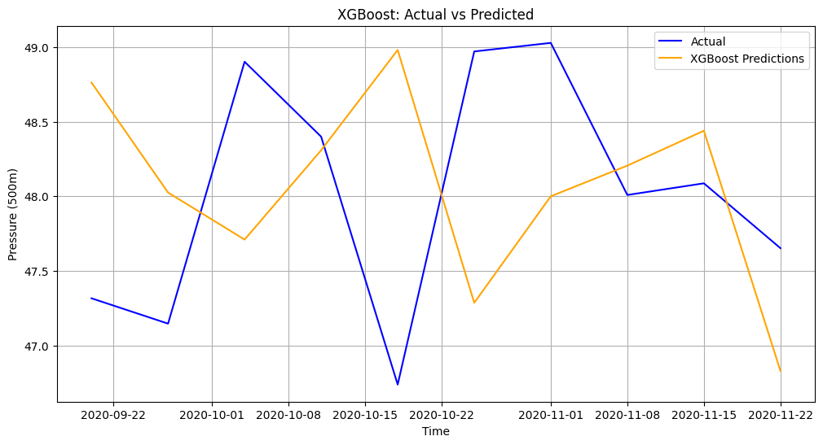
OVERVIEW OBJECTIVES LITERATURE SURVEY METHODOLOGY RESULTS COMPARISONS
AD07 (2019 - 2020) Prediction results for Pressure

Slide 14
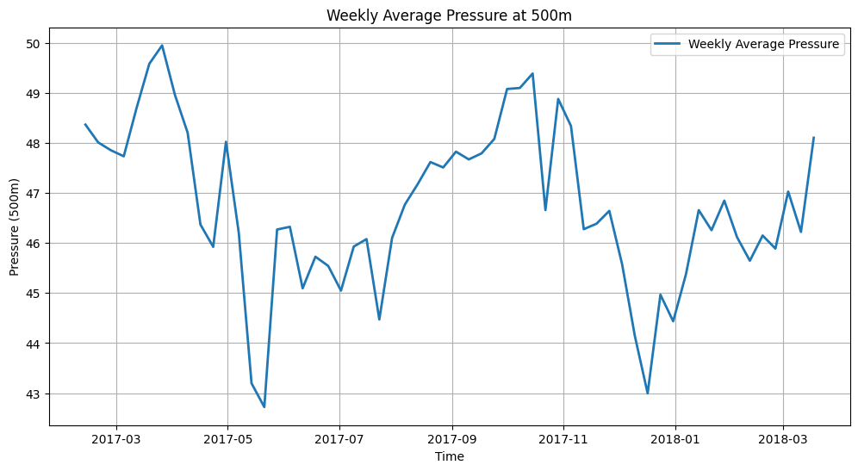
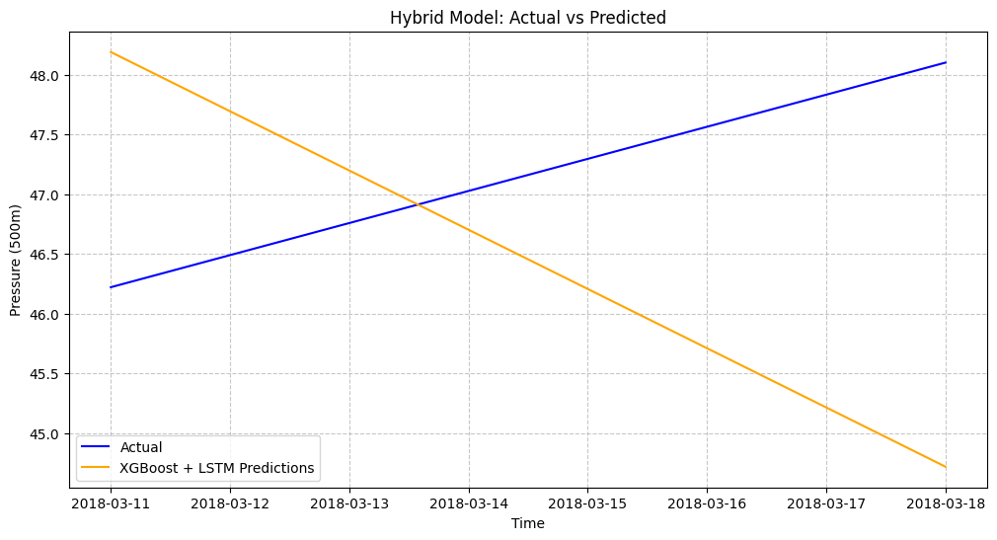
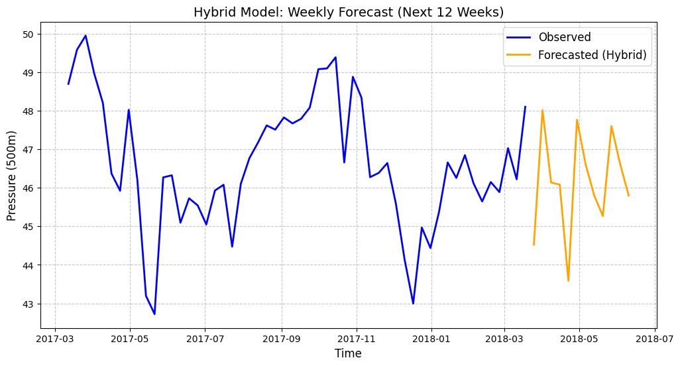
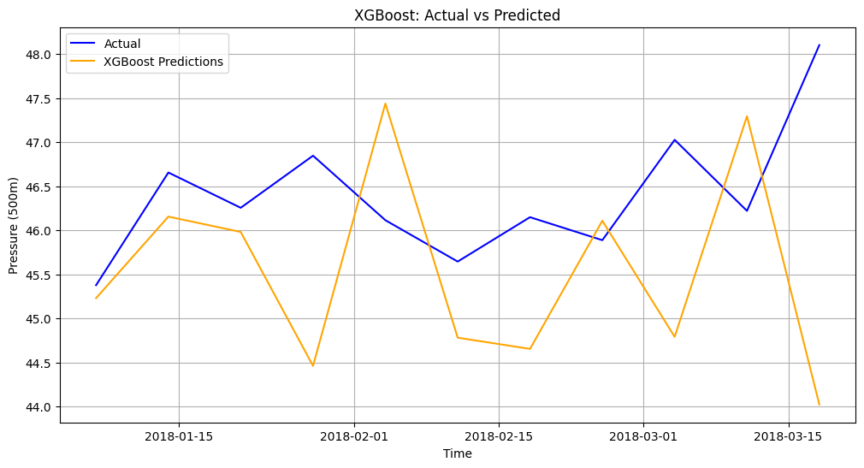
OVERVIEW OBJECTIVES LITERATURE SURVEY METHODOLOGY RESULTS COMPARISONS
BD07 Prediction results for Pressure

Slide 15
OVERVIEW OBJECTIVES LITERATURE SURVEY METHODOLOGY RESULTS COMPARISONS
SR. BUOY NAME / RESULT | RMSE SCORE | MAE SCORE | MAPE (% ERROR)
AD07 (2022 - 2023) | 0.57 | 0.42 | 0.87%
AD07 (2019 - 2020) | 0.61 | 0.52 | 1.07%
BD07 (2018 - 2018) | 2.7 | 2.6 | 5.6%

Slide 16
OVERVIEW OBJECTIVES LITERATURE SURVEY METHODOLOGY RESULTS COMPARISONS
REFERENCES
https://www.niot.res.in/
www.elsevier.com/locate/oceaneng
www.researchgate.com
www.sciencedirect.com
www.isope.org
https://incois.gov.in/portal/datainfo/mb.jsp
THANK YOU !!!

